Slide 1


Shri Govindram Seksaria Institute of Technology and Science
CSE Major Project 2021
“PHISHING WEBSITES DETECTION SYSTEM”
Guide:
Mr. Rajesh Dhakad
Submitted By:
Aditya Raj Patidar (0801CS171006)
Harsh Pastaria (0801CS171027)
Mansoor Rangwala (0801CS171042)
Raghav Parsai (0801CS171060)
Sarvesh Gupta (0801CS171068)

Slide 2
Table of Content
Problem Description
Proposed Solution
Tools & Technologies Used
Design (Activity Diagram)
Demo
Analysis
Module 1
Module 2
Integration Module
Testing and Result
Conclusion
Code & References

Slide 3

Problem Description:
Phishing detection techniques do suffer low detection accuracy and high false alarm especially when novel phishing approaches are introduced.
Besides, the most common technique used, blacklist-based method is inefficient in responding to emanating phishing attacks since registering new domain has become easier, no comprehensive blacklist can ensure a perfect up-to-date database.
There has been a 3x - 4x increase in phishing over mass scale and noticed more in Tier 2 and Tier 3 cities.

Slide 4

What is Phishing??
Phishing is an unfair attempt to obtain sensitive information or data, such as usernames, passwords and credit card details, by pretending to be oneself as a trustworthy entity in an electronic communication.
Phishing often directs users to enter personal information at a fake website which matches the look and feel of the legitimate site such fake websites are known as Phishing Websites.

Slide 5
Literature/Domain Survey:
Best software's available in the market for phishing detection:
INKY Phish Fence: It is an affordable cloud-based email security platform designed to be far more than artificially intelligent. She understands email, searches for signs of fraud, and can spot imposters by a pixel.
BitDam: BitDam offers phishing detection and prevention as part of its comprehensive Advanced Threat Protection solution for business collaboration platforms which includes protection for email, cloud drives, and Instant Messaging – covering threats of any type hidden in files and links.
Cofense: Cofense (formerly PhishMe) provides organizations with the ability to improve their employees’ resilience towards spear phishing, malware, and drive-by attacks and further, facilitate employee-sourced detection of such attacks.

Slide 6

Proposed Solution:
Anti-phishing modules look-up the URL on dozens of phishing symptoms, such as domain names, frame usage, shortening service, double slash redirection and input encryption usage, and compare them with other indications.
Heuristic analysis helps recognize a phishing URL even if it’s not yet featured in available databases , but prediction based on URL alone is not reliable and can give lots of false alarm as newly registered website’s URL also have some features which can be classified as phishing.
To overcome this we will use another filtering mechanism in which the structure and the content of the webpage is compared with the legitimate webpage of similar domain names.

Slide 7
Tools & Technologies Used
Module – 1:
Python Libraries used:
python-whois
Ipaddress
Requests
Numpy
Scikit learn
Pandas
Module – 2:
Python Libraries used:
Gensim
Google
bs4
Module – 3:
chrome plugin development using
html
css
javascript

Slide 8

Requirements:

Slide 9
Functional Requirements:
Typo squatting detection in domain name also called URL hijacking, is a form of cybersquatting which relies on mistakes such as typographical errors made by Internet users when inputting a website address into a web browser or based on typographical errors. Ex google.com and gooogle.com
Cybersquatting or Domain Squatting detection: It is registering, trafficking in, or using a domain name with bad faith intent to profit from the goodwill of a trademark belonging to someone else. Ex flipkart.com and flipkart.co
Anomaly in URLs i.e. URL containing lots of subdomains, very long URL’s, URL’s using URL shortener etc. Phishing URLs often hide the real URL-destination. Subdomains and usernames are inserted in the URL to simulate a legitimate destination and to confuse the user. Phishing Check removes these irrelevant parts of the phishing URL.
Providing REST APIs for easy integration into the browser plugin.

Slide 10
Non-Functional Requirements:
Minimum Time should be taken to detect a URL is phishing or not, so in order to achieve that, we have implemented caching mechanism.
Higher accuracy in detecting whether a website is phishing or not.
User should be able to submit feedback regarding particular domain if it is prone to phishing & particular URL will be marked as phishing if it is reported by several users.

Slide 11

Analysis:
The project contains two major modules:
Module 1 - URL Detector: Detecting URL is phishing or not via machine learning
Module 2 - Structure Analyzer: Verify the URL is phishing or not by analysing HTML Structure.
The URL is passed to Module 1 & generate Phishing Score & if the score is around the threshold score then the URL is passed to Module2 for further analysis.

Slide 12
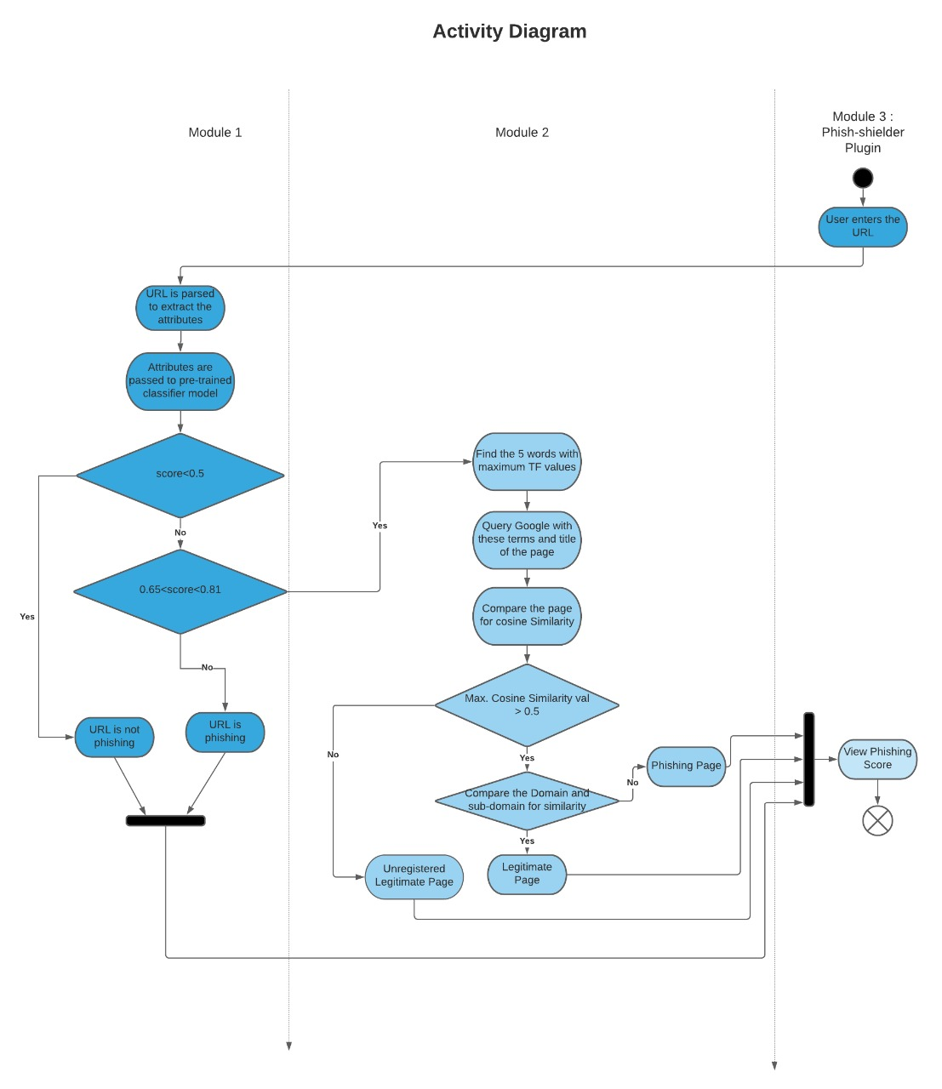
Activity Diagram:

Slide 13

Demo Time

Slide 14
Module: 1

Slide 15
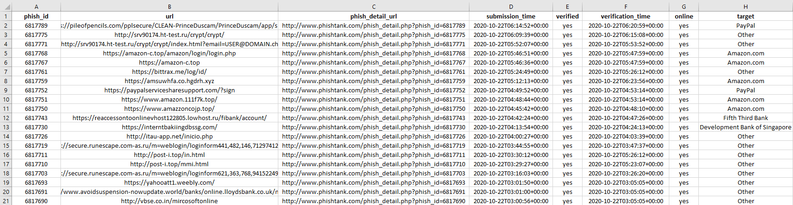
Data Source:
Phishing data set1 (Primary): https://archive.ics.uci.edu/ml/datasets/phishing+websites
Phishing data set2 : https://www.phishtank.com/
Reputed site's rank data: https://www.alexa.com
Raw Dataset (Dataset 2):

Slide 16
Pre-processed Dataset (Attributes):
The data set contains 31 attributes which are calculated from the URL Attributes are:
having_IP_Address { -1,1 } URL_Length { 1,0,-1 } Shortining_Service { 1,-1 }
having_At_Symbol { 1,-1 } double_slash_redirecting { -1,1 } Prefix_Suffix { -1,1 }
having_Sub_Domain { -1,0,1 } SSLfinal_State { -1,1,0 } Domain_registeration_length { -1,1 }
Favicon { 1,-1 } port { 1,-1 } HTTPS_token { -1,1 }
Request_URL { 1,-1 } URL_of_Anchor { -1,0,1 } Links_in_tags { 1,-1,0 }
SFH { -1,1,0 } Submitting_to_email { -1,1 } Abnormal_URL { -1,1 }
Redirect { 0,1 } on_mouseover { 1,-1 } RightClick { 1,-1 }
popUpWidnow { 1,-1 } Iframe { 1,-1 } age_of_domain { -1,1 }
DNSRecord { -1,1 } web_traffic { -1,0,1 } Page_Rank { -1,1 }
Google_Index { 1,-1 } Links_pointing_to_page { 1,0,-1 } Statistical_report { -1,1 }
Result { -1,1 }
-1 indicates: Phishing Attribute
0 indicates: Suspicious Attribute
1 indicates: Non - Phishing Attribute

Slide 17
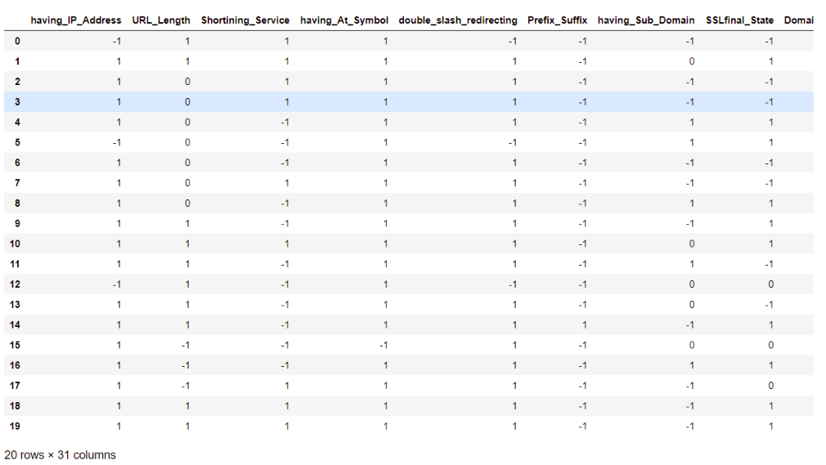
Pre-processed Dataset

Slide 18
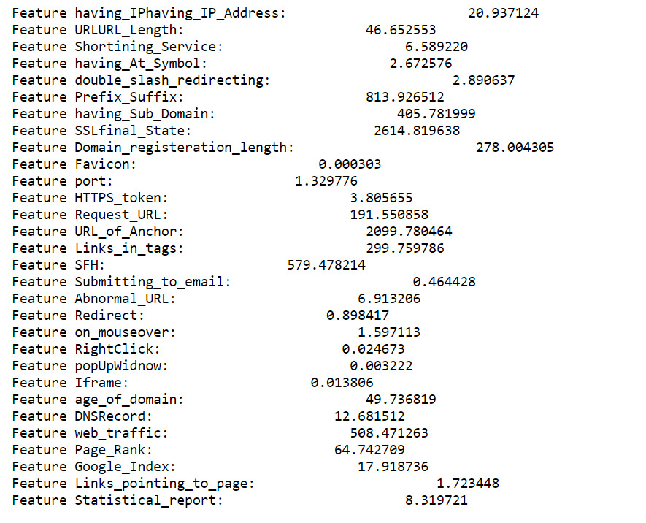
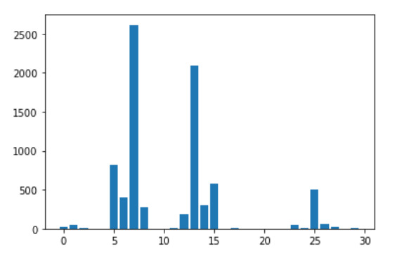
Feature/Attribute Selection
Feature selection is also known as attribute selection is a process of extracting the most relevant features from the dataset and then applying machine learning algorithms for the better performance of the model. A large number of irrelevant features increases the training time exponentially and increase the risk of overfitting.
Chi-square test is used for categorical features in a dataset.

Slide 19
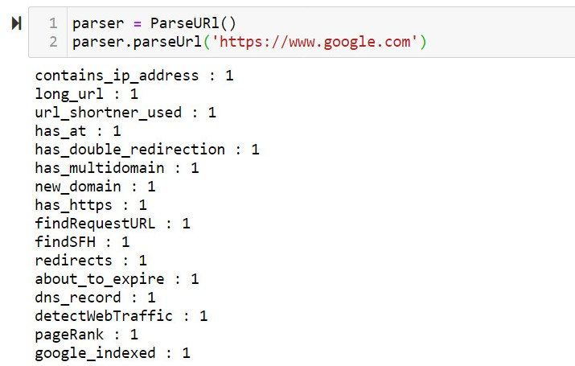
Attribute Parsing
Finally 16 attributes that we will consider for training our model after applying feature selection:
• contains_ip_address • long_url • url_shortner_used • has_at
• has_double_redirection • has_multidomain • new_domain • has_https
• findRequestURL • findSFH • redirects • about_to_expire
• dns_record • detectWebTraffic • pageRank • google_indexed

Slide 20
Model Selection
This module intakes URL as an input and after applying machine learning algorithms generate a phishing score. According to the generated score, the website will be tagged as phishing or normal.
Machine Learning Models that can be used are:
Logistic Regression
Support Vector Machine

Slide 21
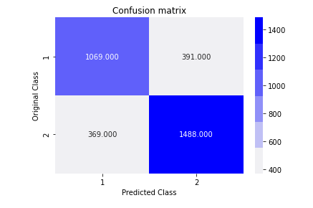
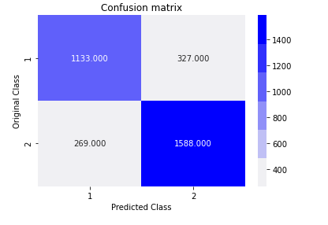
Model Selection
Logistic Regression
Support Vector Machine
TN
FN
FP
TP
Accuracy of Logistic Regression : 0.7708772987639433
Accuracy of Support Vector Machine : 0.8203195658727767

Slide 22
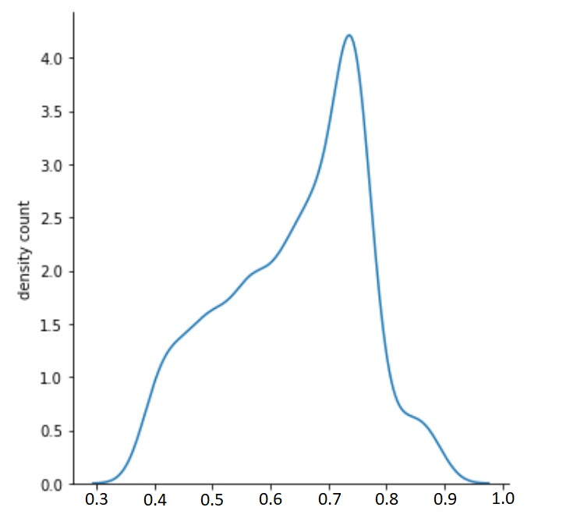
Range Selection
Support Vector Machine (SVM) is used as the machine learning model for module 1.
False Negative values obtained in the range are passed to module 2.
False Negative Output in the range [0.6507983 , 0.81118389] consists of 65% of total false negative.
Hence the range of above density graph is passed to module 2.

Slide 23
Module: 2

Slide 24
Module 2
(Structure Analyzer)
This module examines the content of a web page to determine whether it is legitimate or not, in contrast to other approaches that look at surface characteristics of a web page, for example, the Web page content and its domain name.
To identify the duplicate or near-duplicate webpages we will use the technique:
URL Mining :
In this method, a signature is made using the title of the web page and 5 words of it with maximum TF (term frequency) values. Put that signature for Google search and get the first n web pages. Next step is to compare the web pages each other by HTML code matching and also by checking the textual part of these web pages for cosine similarity.

Slide 25
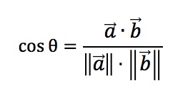
Cosine Similarity
The cosine similarity is the cosine of the angle between two vectors. In text analysis, each vector can represent a document. The greater the value of θ, the less the value of cos θ, thus the less the similarity between two documents.
How to Convert Web page into vector:
Raw texts are preprocessed with the most common words and punctuation removed, and tokenization is done.
A dictionary of unique terms found in the whole corpus is created. Texts are quantified first by calculating the term frequency (tf) for each document. The numbers are used to create a vector for each document where each component in the vector stands for the term frequency in that document.

Slide 26
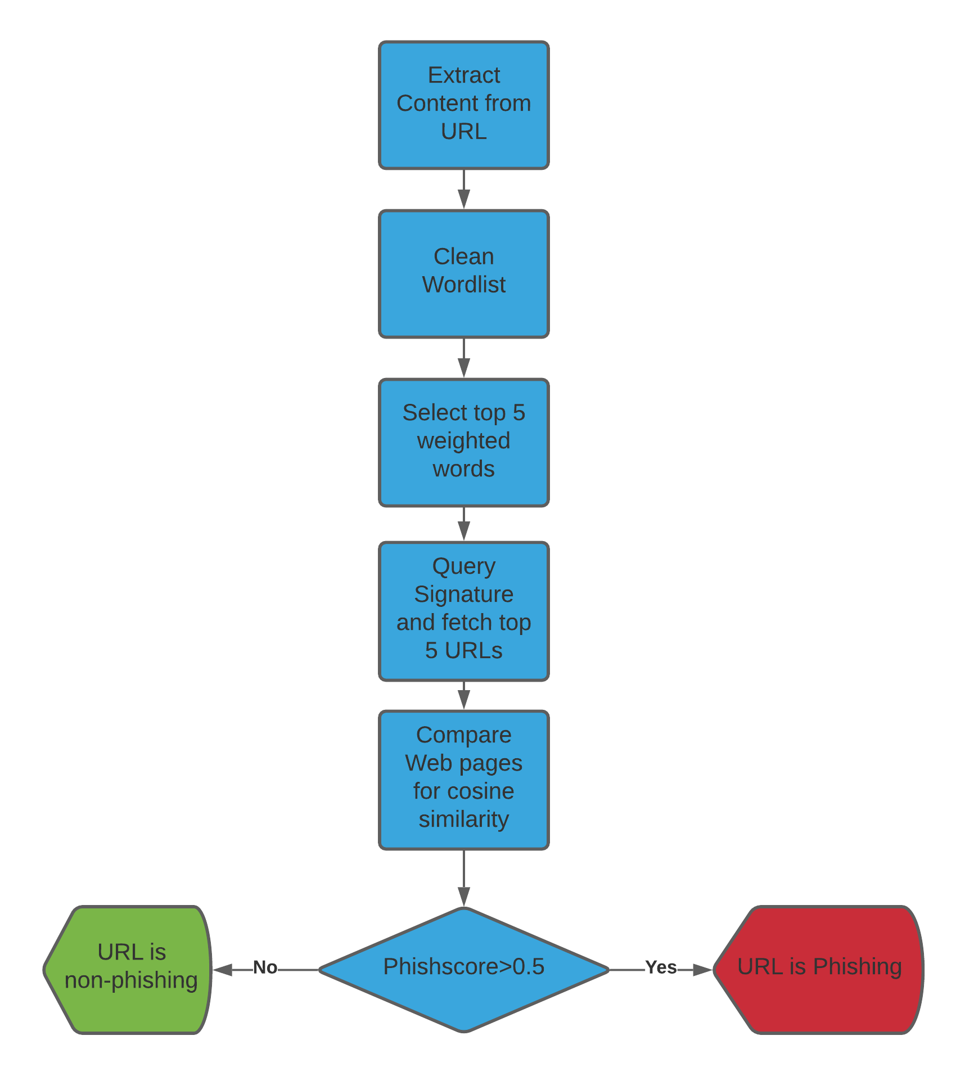

Slide 27
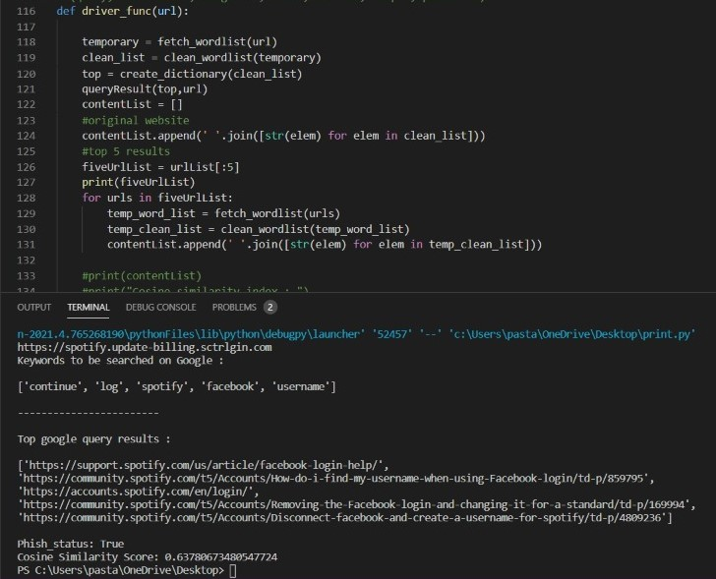
Implementation

Slide 28

Module Integration
Module 1
Module 2

Slide 29
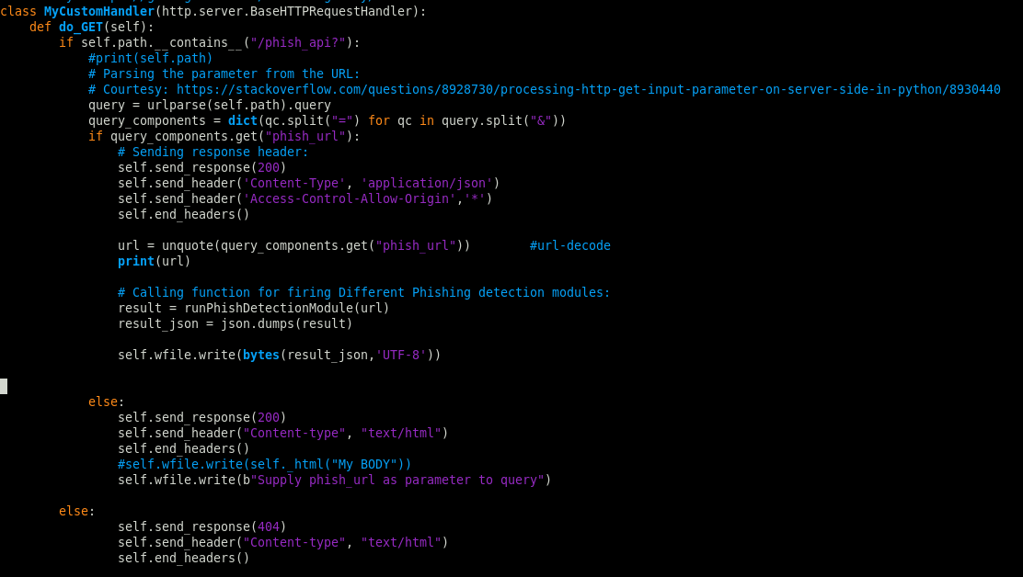
MyCustomHandler is used to provide endpoint /phish_api. It takes phish_url as GET parameter with value of encoded URL which is needed to check whether phishing or not and return JSON response containing phish_status as true/false and phish_score.

Slide 30
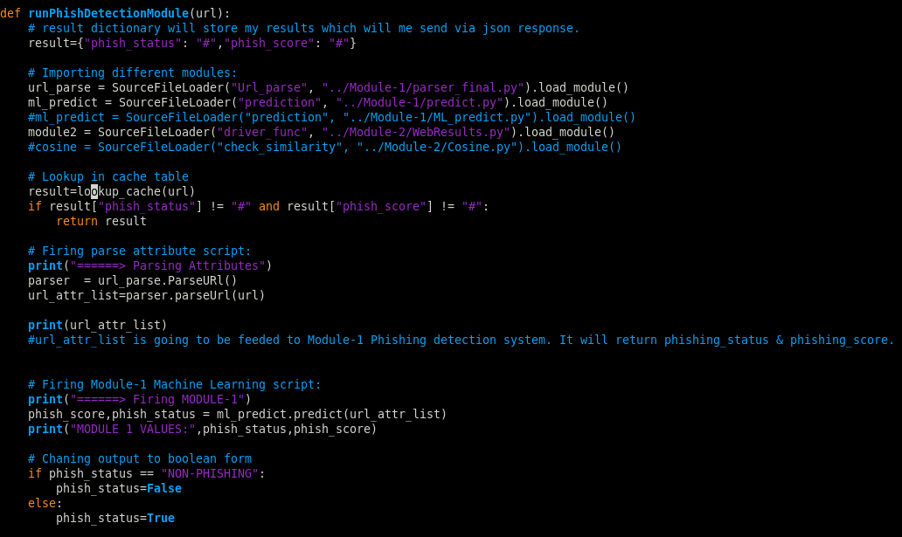
runPhishDetectionModule is used to fire Module-1 and Module-2 (if required) and returns a dictionary containing keys phish_status and phish_score.

Slide 31
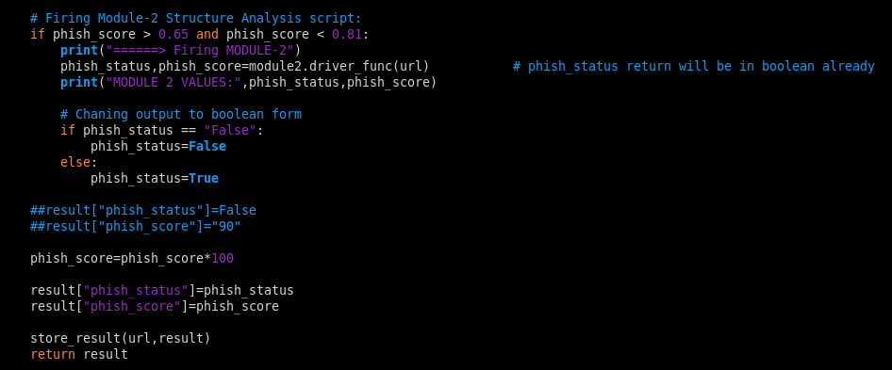

Slide 32
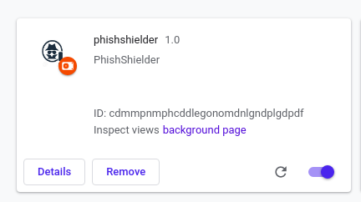
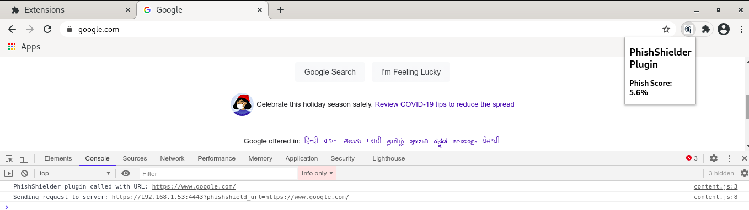
Implementation

Slide 33
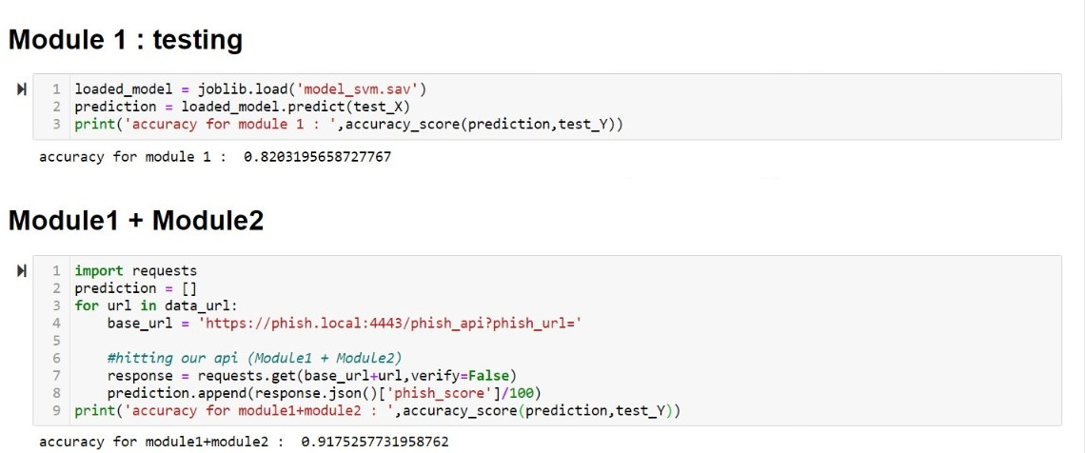
Testing and Result
Accuracy of Module 1: 82.03%
Accuracy After Integration of both the modules: 91.75%

Slide 34
Conclusion
Thus to summarize, we have seen how phishing is a huge threat to the security and safety of the web and how phishing detection is an important problem domain.
We have reviewed some of the traditional approaches to phishing detection namely the Machine learning approach and CANTINA approach, We then selected the combination of both the approaches based on their performance and built a Chrome extension for detecting phishing web pages.
The extension allows easy deployment of our phishing detection model to end-users.
The reported accuracy score on the data-set on module 1 is 82.032%.
And overall Efficiency (accuracy score) of our project (i.e. after integrating module 1 and module 2) is 91.75%.
Module 2 helps us to increase the Efficiency by around 9.72%.

Slide 35
Code
Implementation:
https://github.com/mansoorrangwala/PhishingDetectionSystem

Slide 36
Reference:
Phishing Websites Dataset1 [Online]: https://archive.ics.uci.edu/ml/datasets/phishing+websites
Phishing Websites Dataset2 [Online]: https://www.phishtank.com/
Existing Phishing detection techniques & domain survey [Research Paper]: https://ieeexplore.ieee.org/document/8862697
URL based Phishing detection using Machine Learning [Research Paper]: https://ieeexplore.ieee.org/abstract/document/8858325
Detecting phishing websites using machine learning [Online]: https://medium.com/intel-software-innovators/detecting-phishing-websites-using-machine-learning-de723bf2f946
Content-Based Approach to Detecting Phishing Web Sites (CANTINA) [Research Paper]: https://www.cs.cmu.edu/~jasonh/publications/www2007-cantina-final.pdf
A Novel Phishing Page Detection Mechanism Using HTML Source Code Comparison and Cosine Similarity [Research Paper]: https://ieeexplore.ieee.org/abstract/document/6906016

Slide 37


Thank You!!!

